Slide 1
Marketing Analytics
Raj Venkatesan

Slide 2

Billy Bean Oakland A’s General Manager, 2002

Slide 3
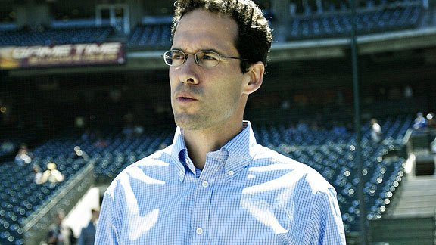
Paul DePodesta Assistant to General Manager Oakland A’s, 2002

Slide 4
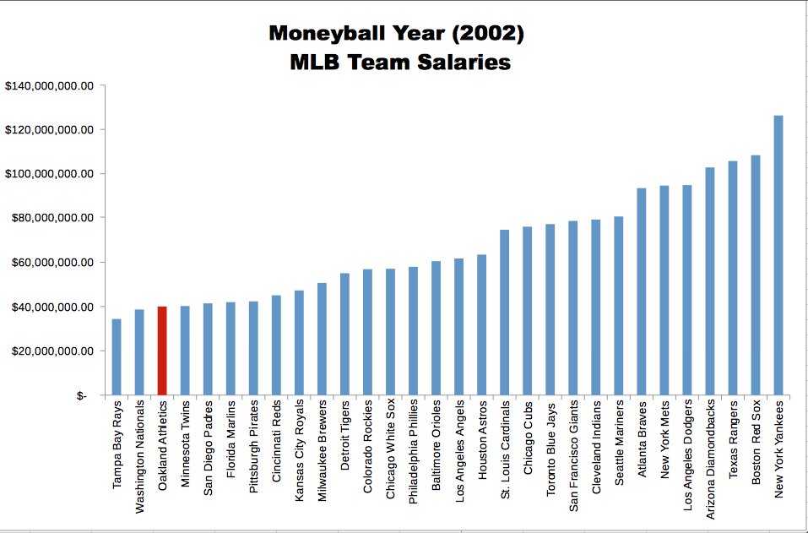

Slide 5
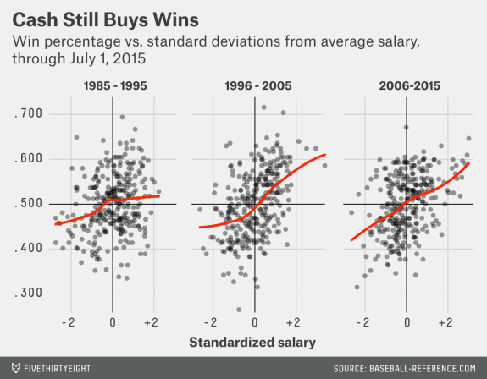

Slide 6
2002 MLB Playoff Teams
NY Yankees
Anaheim
Oakland
Minnesota
Atlanta
San Francisco
Arizona
St Louis

Slide 7
Sashi Brown

Slide 8
Jim
Schwartz
Ryan
Paganetti

Slide 9
What are some companies that remind you of the Oakland A’s, Eagles, etc. & Why?
03/05/2016

Slide 10
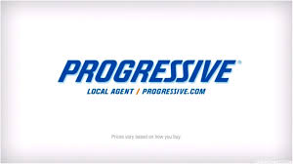




Slide 11
Weather Co.
2008
Landmark communications sells weather channel to a consortium of NBC, Bain Capital, and Blackstone
Competition from Monsanto, Yahoo, and Google
2012
David Kenny steps in as CEO
Acquires weather central and weather underground (new source of data)
Develops industry specific applications
weather data for more targeted advertising by cross-referencing consumer data analysis
Total Turbulence product for aviation
Weather information embedded in car systems
Partnerships with American Red Cross, focus on disaster preparedness

Slide 12
IBM

Slide 14
But the Ability to Harness Big Data for Insights is RARE
86% of respondents in a McKinsey Survey say their organizations have been at best only somewhat effective at meeting the primary objective of their data and analytics programs.
Capturing data-related opportunities to improve revenues, boost productivity and sometimes create entirely new businesses puts
new demands on companies-requiring not only new talent.....but also significant changes in mindsets....
McKinsey Quarterly, November 2013

Slide 15
Marketing Analytics?
Optimization
“What’s the best that can happen?”
Predictive and Prescriptive Analytics
(the “so what”)
Predictive Modeling
“What will happen next?”
Randomized Testing
“What if we try this?”
Degree
of
Intelligence
Statistical Analysis
“Why is this happening?”
Alerts
“What actions are needed?”
Query/drill down
“What exactly is the problem?”
Descriptive Analytics
(the “what”)
Ad hoc reports
“How many, how often, where?”
Standard Reports
“What happened?”
Metrics, Then Analytics!
Source: Thomas Davenport, Competing on Analytics, 2007

Slide 16
A Process for Data Driven Marketing Strategy
Business Challenges
Transformation
Metrics and Mental Models
Learning
Insights
Data

Slide 17
The Marketing Process
Customer
Margin
Company
ROI
Objectives
Competitor
CLV
Collaborators
Context
Financials
Strategy
Product
Segmentation
Price
Targeting
Place
Tactics
Positioning
Promotion
Notes:
Welcome! This week, we’re going to talk about the marketing process. You’ve probably heard of this in other marketing courses, but this week, we’re going to look at in the context of one very prominent company: Airbnb. You’ll see how the marketing process works for them both with and without data—and quickly realize what a powerful tool data is to help companies improve their performance and profitability.

Slide 18
Customer
Margin
Company
ROI
Objectives
Competitor
CLV
Collaborators
Context
Financials
Strategy
Product
Segmentation
Price
Targeting
Place
Tactics
Positioning
Promotion

Slide 19

Airbnb Objectives
Customer Company Competitor Collaboration Context
You and Me
Airbnb
Hotels
You and Me
Sharing Economy

Slide 20
Customer
Margin
Company
ROI
Objectives
Competitor
CLV
Collaborators
Context
Financials
Strategy
Product
Segmentation
Price
Targeting
Place
Tactics
Positioning
Promotion

Slide 21

Airbnb Strategy
Segmentation
Location Adventure Price Vacation Family Students

Slide 22

Airbnb Strategy
Targeting
Location Adventure Price Vacation Family Students

Slide 23

Airbnb Strategy
Positioning
Value Propositions
Location Adventure Price Vacation Family Students

Slide 24
Customer
Margin
Company
ROI
Objectives
Competitor
CLV
Collaborators
Context
Financials
Strategy
Product
Segmentation
Price
Targeting
Place
Tactics
Positioning
Promotion

Slide 25
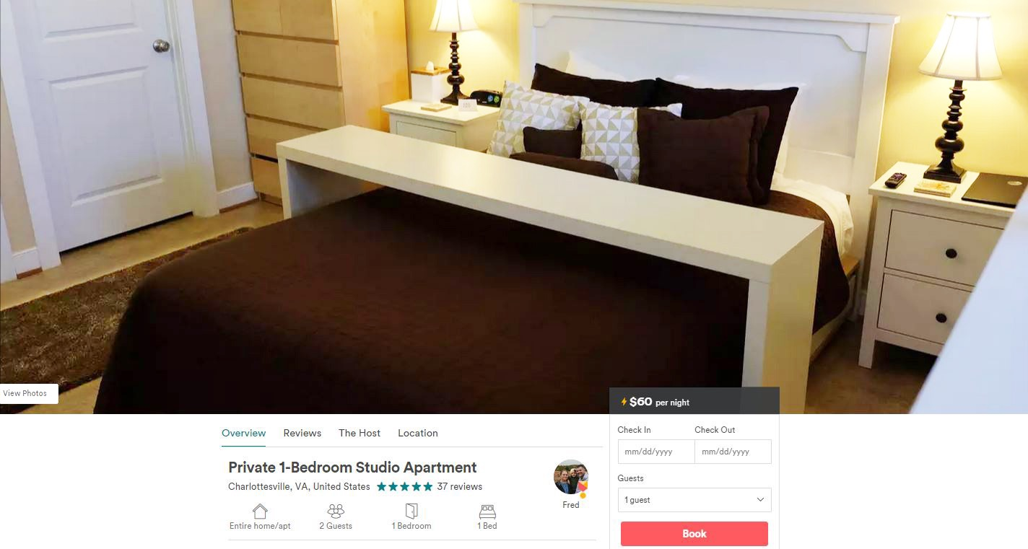
Airbnb Tactics: Product
Notes:
Properties/booking process/website - https://www.airbnb.com/rooms/14139177#neighborhood

Slide 26
Airbnb Tactics: Price

Slide 27
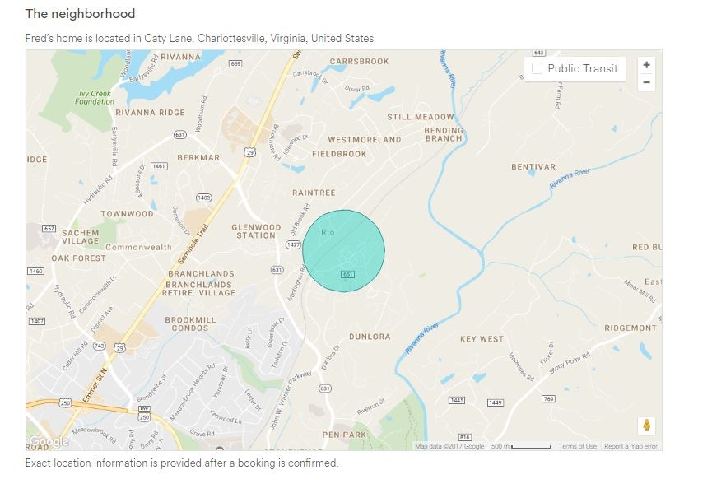
Airbnb Tactics: Location

Slide 28
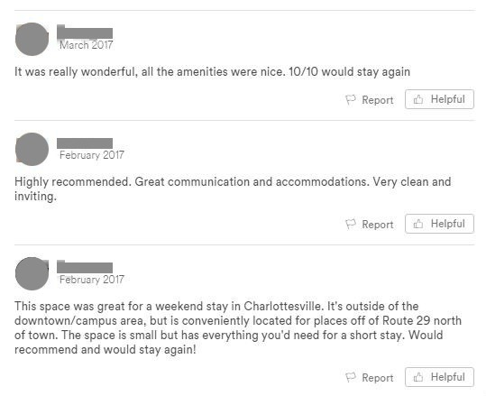
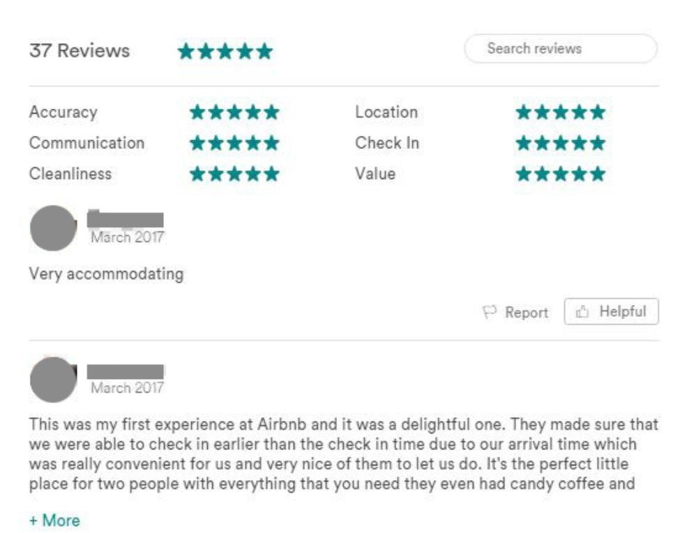
Airbnb Tactics: Promotion
Notes:
Review/ Ads

Slide 29
Customer
Margin
Company
ROI
Objectives
Competitor
CLV
Collaborators
Context
Financials
Strategy
Product
Segmentation
Price
Targeting
Place
Tactics
Positioning
Promotion

Slide 30
Airbnb Financials
Margin
ROI
CLV

Slide 31
How Does Airbnb Make Money?
Guests
6-12 %
Reservation subtotal
Airbnb
3 %
Service fee
Host
Notes:
Charge both hosts and guests.
Guests pay 6-12% of the reservation subtotal.
Reservation fee % reduces with price.
Hosts pay a 3% service fee.

Slide 32
Airbnb’s Strategic Challenge
How do we improve the rental prospects for out hosts and identify better rental options for our guests?
How do we leverage the user generated content on our website?
Is there value in improving the pricing of properties?

Slide 33
Airbnb Marketing Strategy with Data
Mental Model
Price
Fee
Profit (AirBNB)
Star Rating
Rental Nights
Review
Property Attributes
Profit = Rental Nights * Price * Fee
Rental Nights = f(Price, Star Rating, Review, Property Attributes)

Slide 34

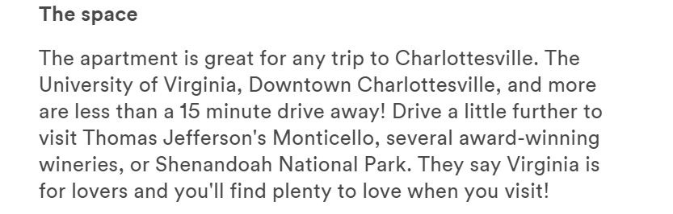
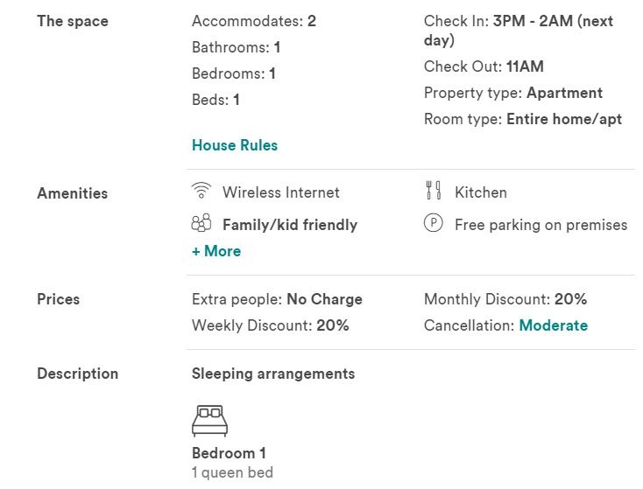
Analytics - Airbnb
Regression
$ 60 x 1 night
# of Rental Nights
Text Analytics
Review Sentiment

Slide 35

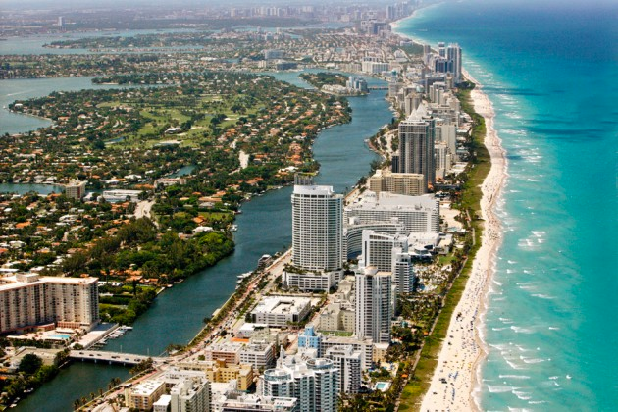
Insights Gained - Airbnb Data Collection

Slide 36
Insights Gained - Airbnb Data Collection
Use a region-specific strategy
Review Sentiment
Cleaning Fees
Price
Security Deposit
Cleaning Fees

Slide 37
Key Takeaways
Marketing is both an art and a science
Analytics provides marketing managers the opportunity to test intuition about marketing
Insights from analytics can change widely held assumptions
Confidence about marketing decisions is higher when it is informed from analytics

Slide 38
Module | Case | Tool
Product Analytics | Best Buy, Sticks Kebab | Segmentation - Cluster Analysis
 | Netflix | Collaborative Filtering – Slope One, Customer Lifetime Value
Marketing Mix | Vodka Industry | Time series regression – Unit Roots, Bias in Coefficients
 | Portland Trailblazers | Conjoint, Pricing
Customer Analytics | Relay C | Binomial Logistic Regression Correlation and Causation
Digital Analytics | Compare.com | Marketing Experiments, A/B Testing

Slide 39
Course Requirements
An individual quiz after week 8
A team capstone project- Presentations are due on week 10
An individual final exam during week 11 – Simulation Exercise
2 team homework assignments – Sticks Kebob and Relay Foods
Class Participation
XlStat (other statistical analysis software)
Difference in expertise with analytics

Slide 40
Project
Project Idea (2 days after week 4 live session), Plan, Final Submission
Need to use secondary or primary data
10+ datasets are provided on LMS
Can obtain a dataset online (e.g., Kaggle, https://data.world/datasets/open-data https://data.fivethirtyeight.com/, or https://catalog.data.gov/dataset)
Can bring your own data also

Slide 41
Important Deadlines
2 Days after Week 4 Live Session
Project Team and Idea Submission on LMS

Slide 42
